Slide 1
ANPR for Indian Number Plates
Raghavan Naresh Sarangapani,
ECE 595 – Introduction to 2D/3D Image Processing

Slide 2
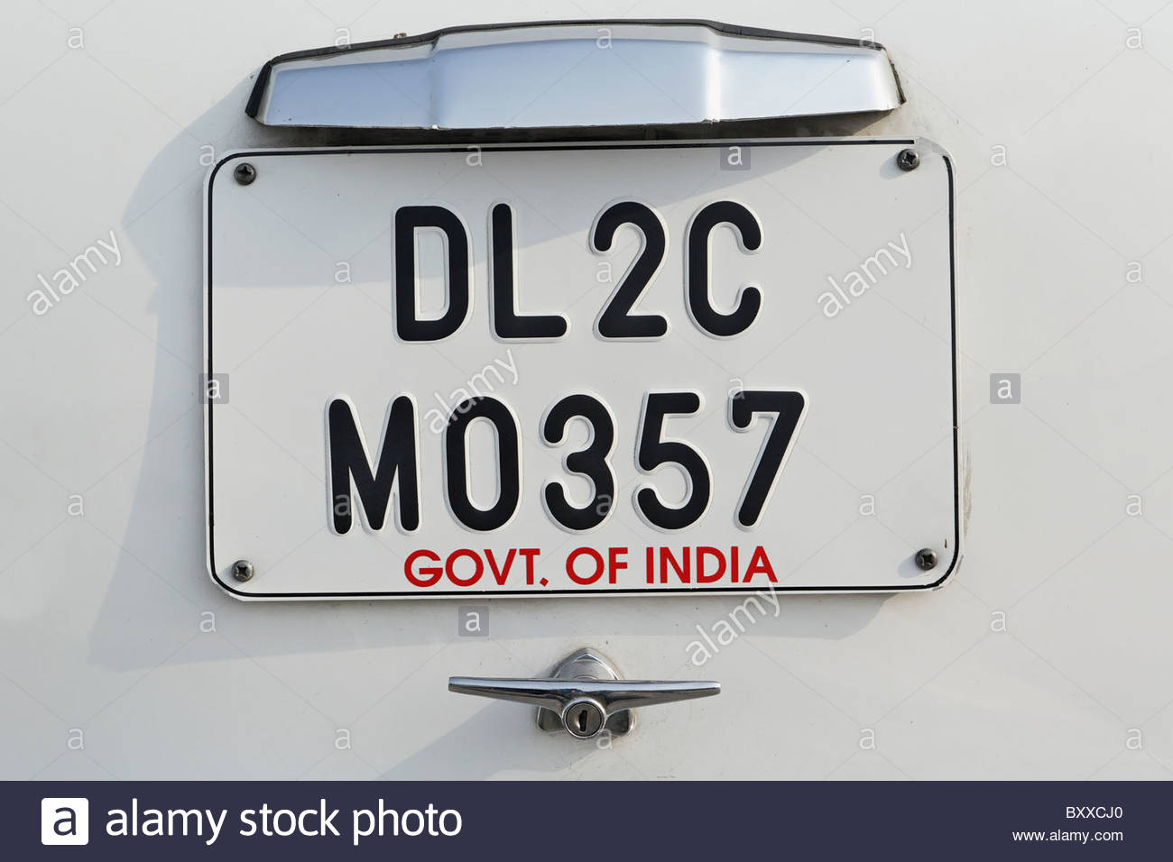
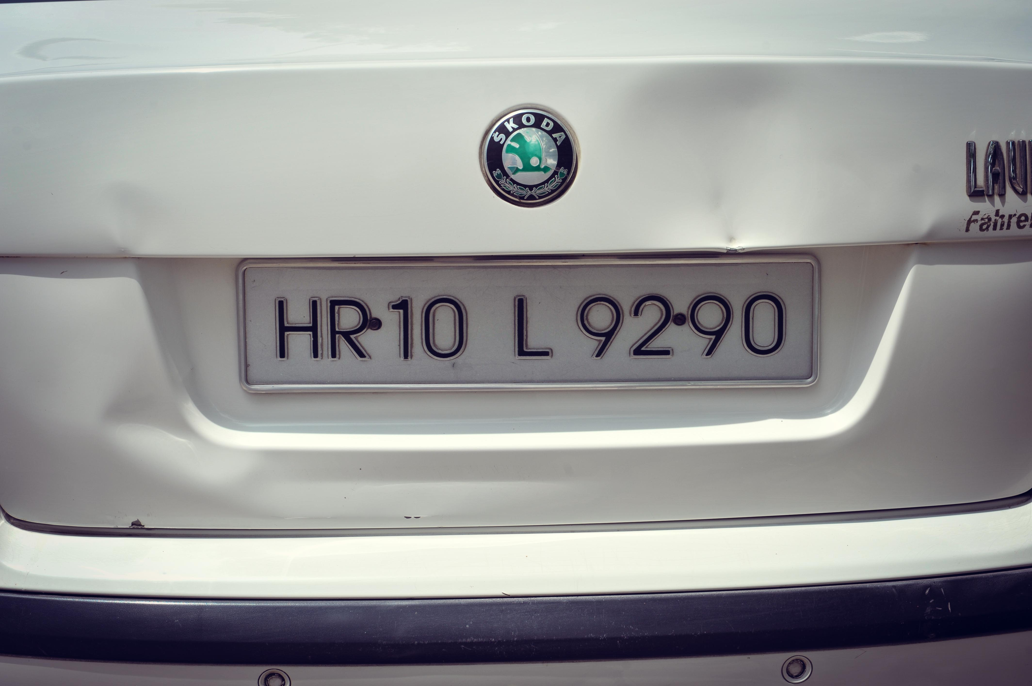
ANPR and complexity with Indian Number plates
ANPR – Automatic Number Plate Recognition.
Support available for USA and Europe, but limited support for other countries.
Problem with Indian plates :
Two lines
Different fonts
No fixed standard

Slide 3
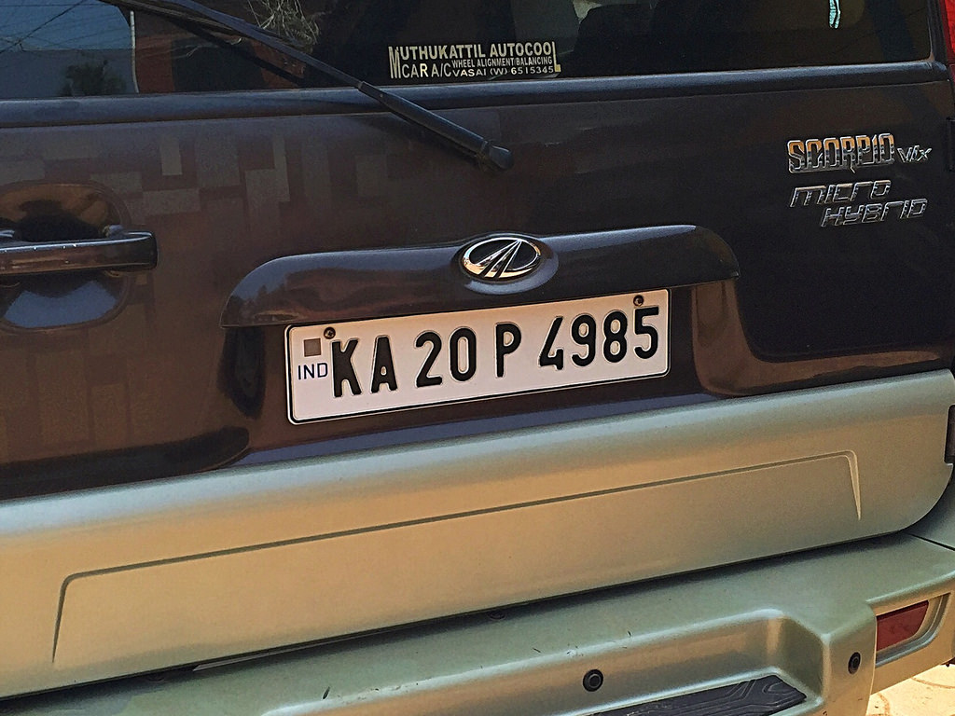
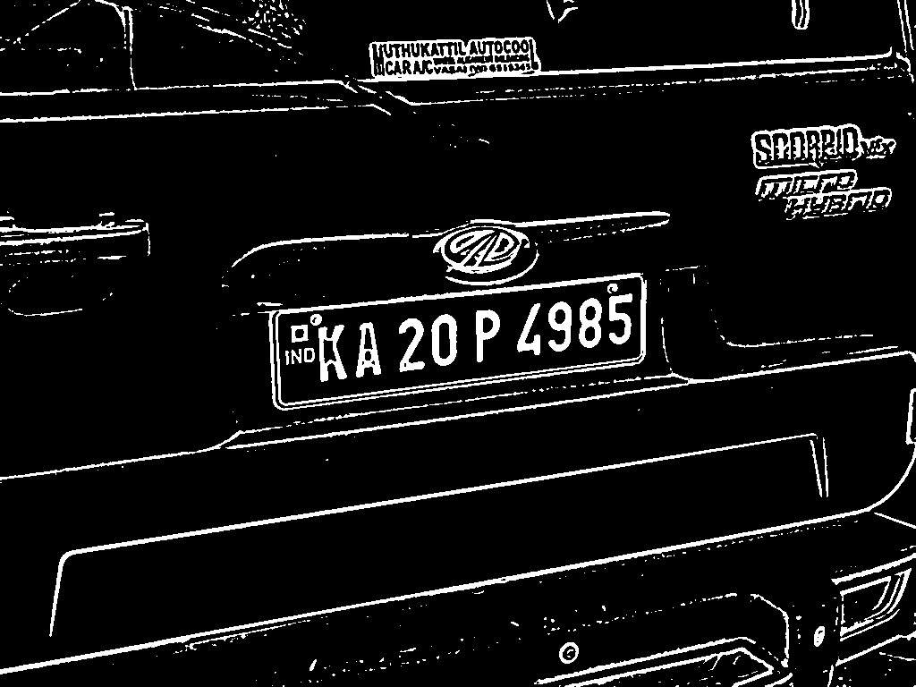
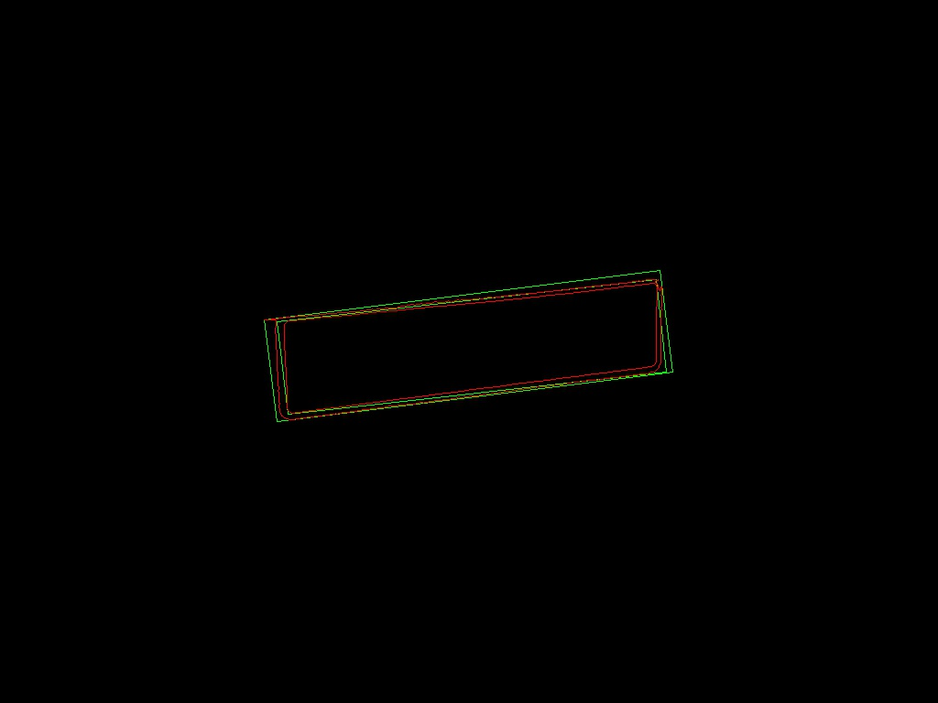
Implementation
Preprocessing Image:
HSV channel.
Morphological filter
Thresholding
Contours for plate
Using open cv find contours
Matching with number plate dimensions.

Slide 4


Extracting the plates
ROI based on contour closest to rectangle.
Rotation matrix
Affine transform to remove skew
Finding characters:
Preprocess image to get threshold.
Find contour inside the image.
Draw rectangles around contour.
Find biggest area, neglect contours with area very smaller than that.

Slide 5
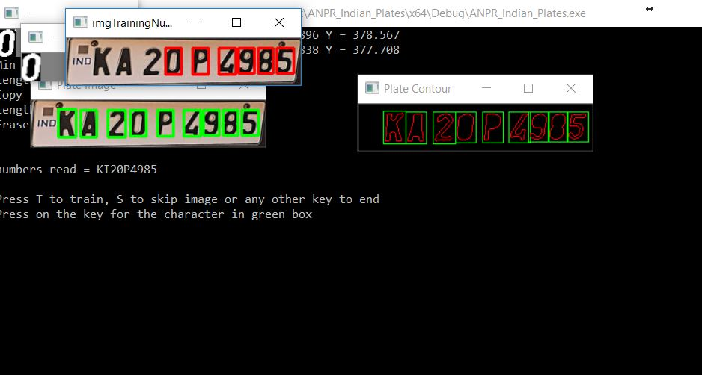
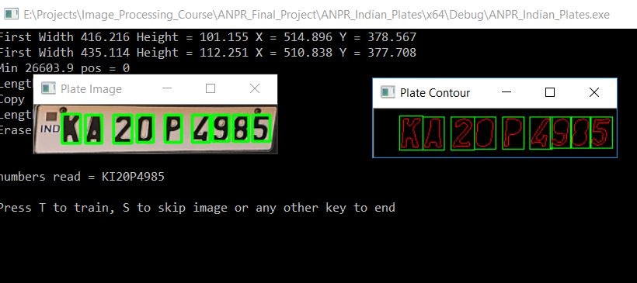
K-means clustering
Image and data classified separately.
Input is matched with neighbors in the dataset.
K-levels depending on availability of data.
Given level of accuracy for predictions.
Possibility to train dataset with user input.

Slide 6
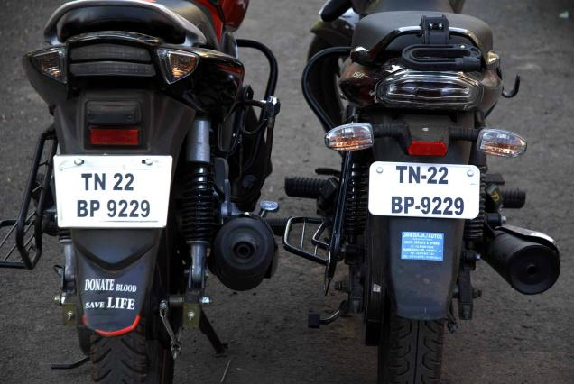
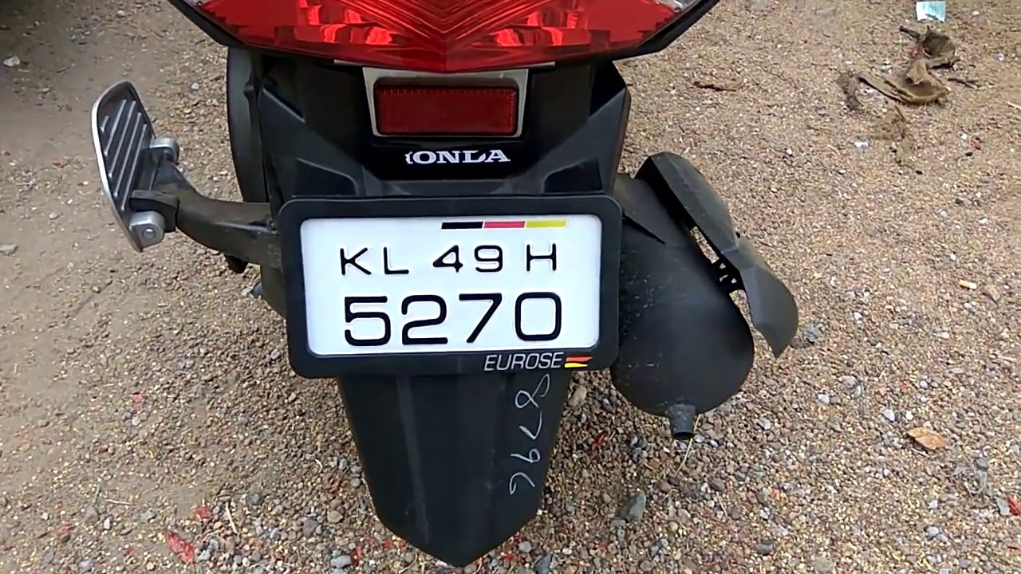
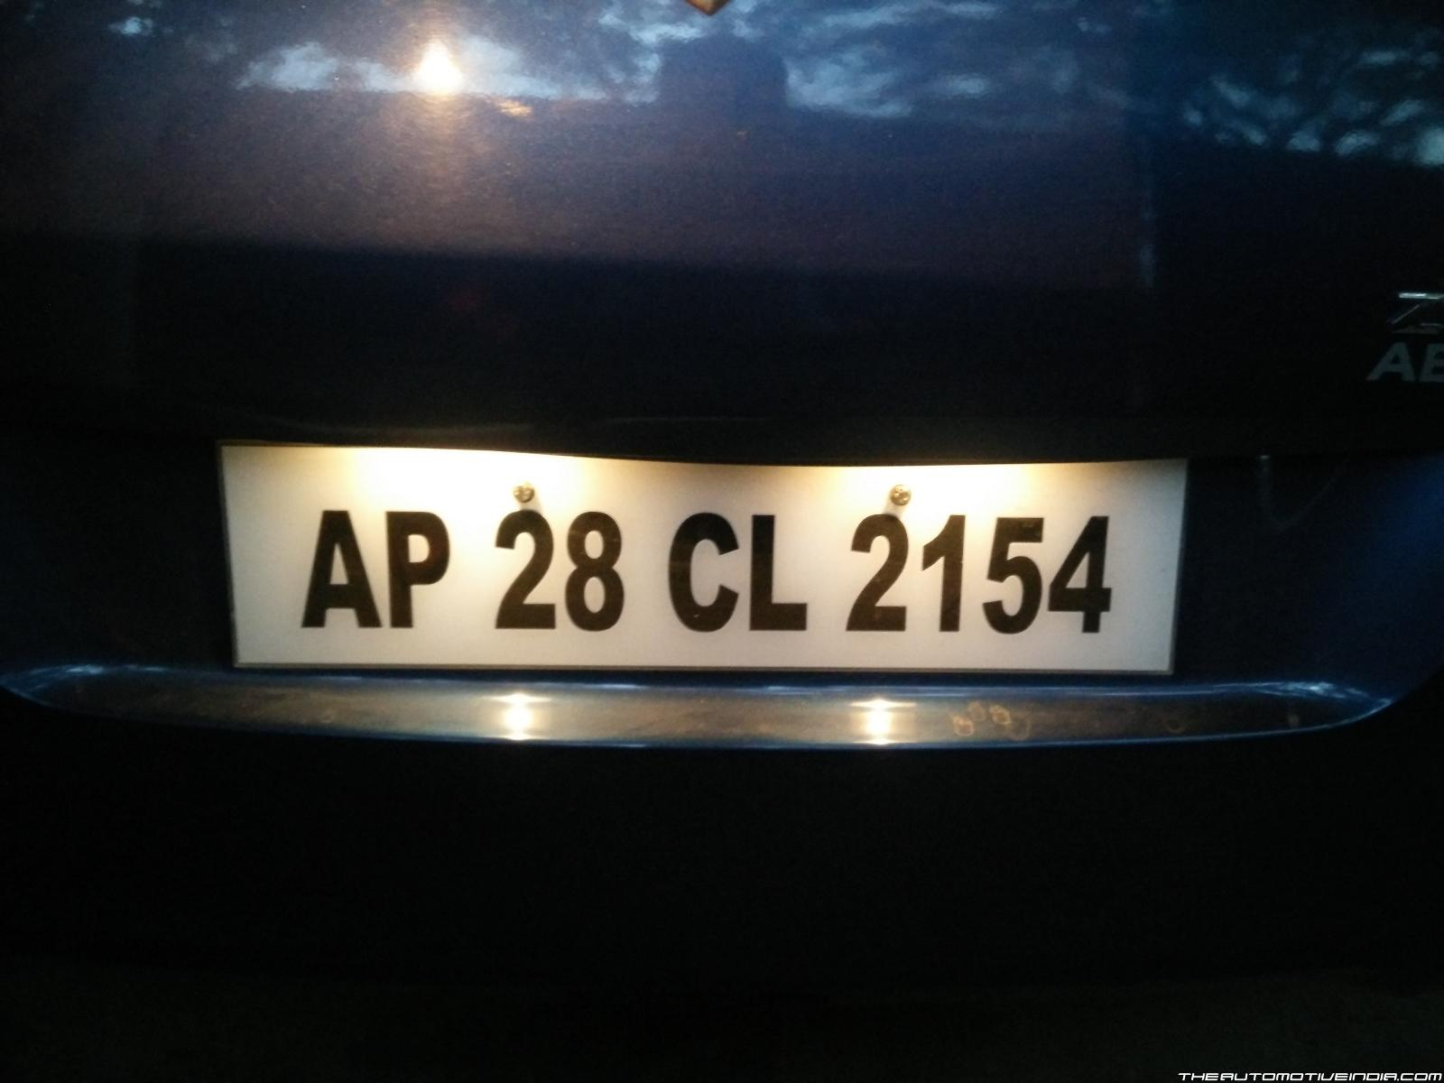


Issues and Future Development
Multiple Plates:
Different fonts in same plate.
Design feature affecting images.
Issues with lighting
Exploring options like Tessaract and Tensorflow.

Slide 7
Thank you, Questions or Suggestions.

